Slide 1

Asset Security

Slide 2
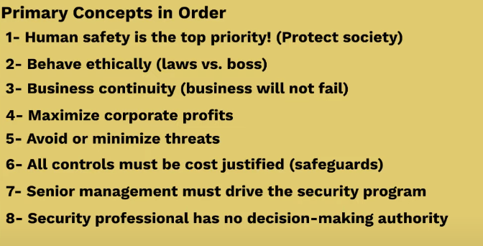

Slide 3
THE DATA LIFECYCLE
Create
Destroy
Store
Archive
Use
Share

Slide 4
THE INFORMATION LIFECYCLE
Creation
DOMAIN 7: SECURITY OPERATIONS
Destruction
Classification
Focuses a bit more on
“information protection”
Archive
Storage
there isn’t a consistent standard used to identify each stage or phase of a data lifecycle.
Usage

Slide 5
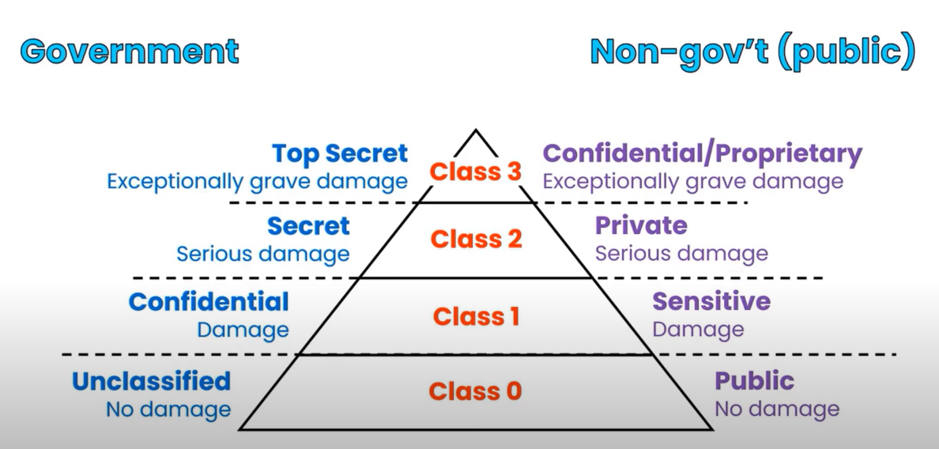
Information Classification

Slide 6
DOMAIN 2: DATA SECURITY CONTROLS
Data Security Controls
Marking, Labeling, Handling, Classification.
Classification is the most important!
Data handling. Shipping, Chain of Custody.
Data destruction. Erasing, Clearing (overwriting w/
unclassified data).
Record retention. If the retention policy is 1 year, it should
be destroyed when it ages out (>1 year).
Tape Backup Security. Secure facility, tapes labeled
ensures all understand the classification of the data.

Slide 7
DOMAIN 2: ASSET CLASSIFICATIONS
Security Control
Baseline
Provides a listing of controls that an
organization can apply as a baseline.

Slide 8
DOMAIN 2: ASSET CLASSIFICATIONS
Asset Classifications
Asset classifications should
match the data classifications.

Slide 9
DOMAIN 2: DEFINING SENSITIVE DATA
Defining Sensitive Data
Sensitive data is any information that isn’t public or
unclassified.
Personally Identifiable Information (PII). any information that can
identify an individual (name, SSN, birthdate/place, biometric records, etc)
Protected Health Information (PHI). and health-
related information that can be related to a specific person.
covered by HIPAA (from DOMAIN 1)

Slide 10
Privacy Requirements in Compliance
Privacy is protection of Personally Identifiable Information (Pll) about individuals or Sensitive Personal Information (SPI) that can be used to identify a person in context with a group.
National Institute of Standards and Technology (NIST) has published a guide to protecting the confidentiality of the personally identifiable information-wide
NIST special publication 800-122.

Slide 11
DOMAIN 2: DATA OWNERSHIP
KNOW THESE TWO ROLES!
The most likely to show up on the exam?
Data Owner. Usually a member of senior management. Can delegate some day-to-day duties. Cannot delegate total responsibility.
Data Custodian. Usually someone in the IT department. Does not decide what controls are needed, but does implement controls for data owner
TIP: if question mentions "day-to-day" it’s custodian!

Slide 12
DOMAIN 2: DATA OWNERSHIP
OTHER ROLES
Be prepared to answer questions on other roles
Data Administrators. Responsible for granting appropriate
access to personnel (often via RBAC).
User. any person who accesses data via a computing
system to accomplish work tasks.
Business/Mission Owners. Can overlap with the
responsibilities of the system owner or be same role
Asset Owners. Owns asset or system that processes
sensitive data and associated security plans

Slide 13
DOMAIN 2: GDPR TERMS AND CONCEPTS
GDPR Terms and Requirements
Be prepared to answer questions on other roles
Data Processor. A natural or legal person, public authority,
agency, or other body, which processes personal data solely
on behalf of the data controller.
Data Controller. The person or entity that controls processing of the data.
Data Transfer. GDPR restricts data transfers to countries outside the EU.

Slide 14
DOMAIN 2: GDPR TERMS AND CONCEPTS
Reducing GDPR Exposure
Steps to reduce or eliminate GDPR requirements
Anonymization. The process of removing all relevant data
so that it is impossible to identify original subject or person.
If done effectively, the GDPR is no longer relevant for the
anonymized data.
Pseudonymization. The process of using pseudonyms
(aliases) to represent other data.
Good only if you don’t need the data!
Can result in less stringent requirements than would
otherwise apply under the GDPR.
Use if you need data and want to reduce exposure

Slide 15
FOR THE
Be familiar with the GDPR terms,
data roles, security controls.
EXAM
Notification of data breach
must be made within 72 hours

Slide 16
DOMAIN 2: ASSET CLASSIFICATIONS
Data protection
Confidentiality is often protected through
encryption (at rest and in transport)
We’ll cover encryption in DOMAIN 3

Slide 17
Emanations/Tempest
TEMPEST is a U.S. National Security Agency specification and a NATO certification referring to spying on information systems through leaking emanations, including unintentional radio or electrical signals, sounds, and vibrations.
Defines several shielding standards (many are classified)
A Faraday cage or Faraday shield is an enclosure used to block electromagnetic fields
Protects against emanations
Shielding can be for small or very large areas

Slide 18
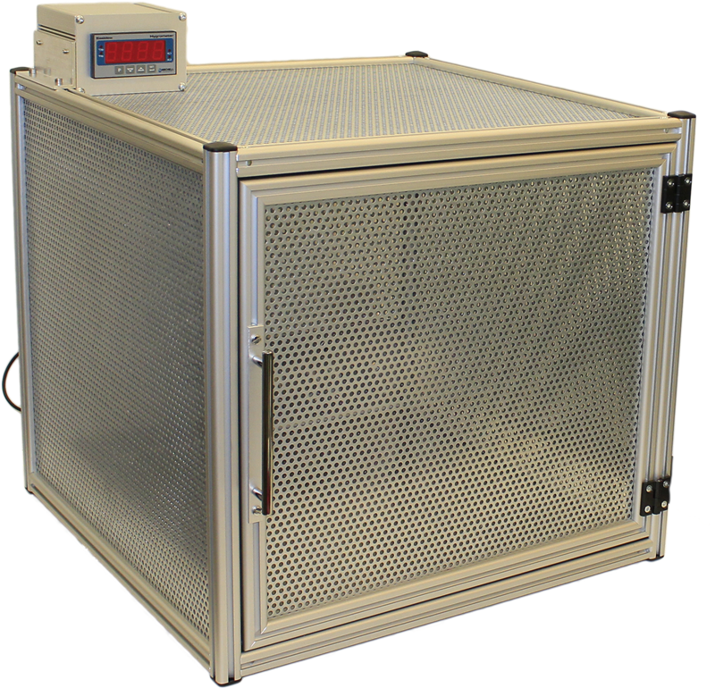
Faraday Cage Example

Slide 19
FOR THE
Keeping data longer than necessary
presents unnecessary legal issues
EXAM

Slide 20

Data Remanence
Data remanence is the residual representation of digital data that remains even after attempts have been made to remove or erase the data.

Slide 21
DOMAIN 2: DESTROYING DATA
Data Destruction Methods
Erasing. performing a delete operation against a file, files, or
media.
data is typically recoverable
Clearing (overwriting). preparing media for reuse and
ensuring data cannot be recovered using traditional
recovery tools
Purging. a more intense form of clearing that prepares
media for reuse in less secure environments.
Degaussing. creates a strong magnetic field that erases
data on some media.
Destruction. the final stage in the lifecycle of media and is
the most secure method of sanitizing media.

Slide 22
Standards and Guidelines for Sanitation
NIST SP 800-88 (Guidelines for Media Sanitization): Recommendations and best practices for media sanitization outlined in this document.
DoD 5220.22-M: Department of Defense standard for clearing and sanitizing data from storage media.

